Slide 1
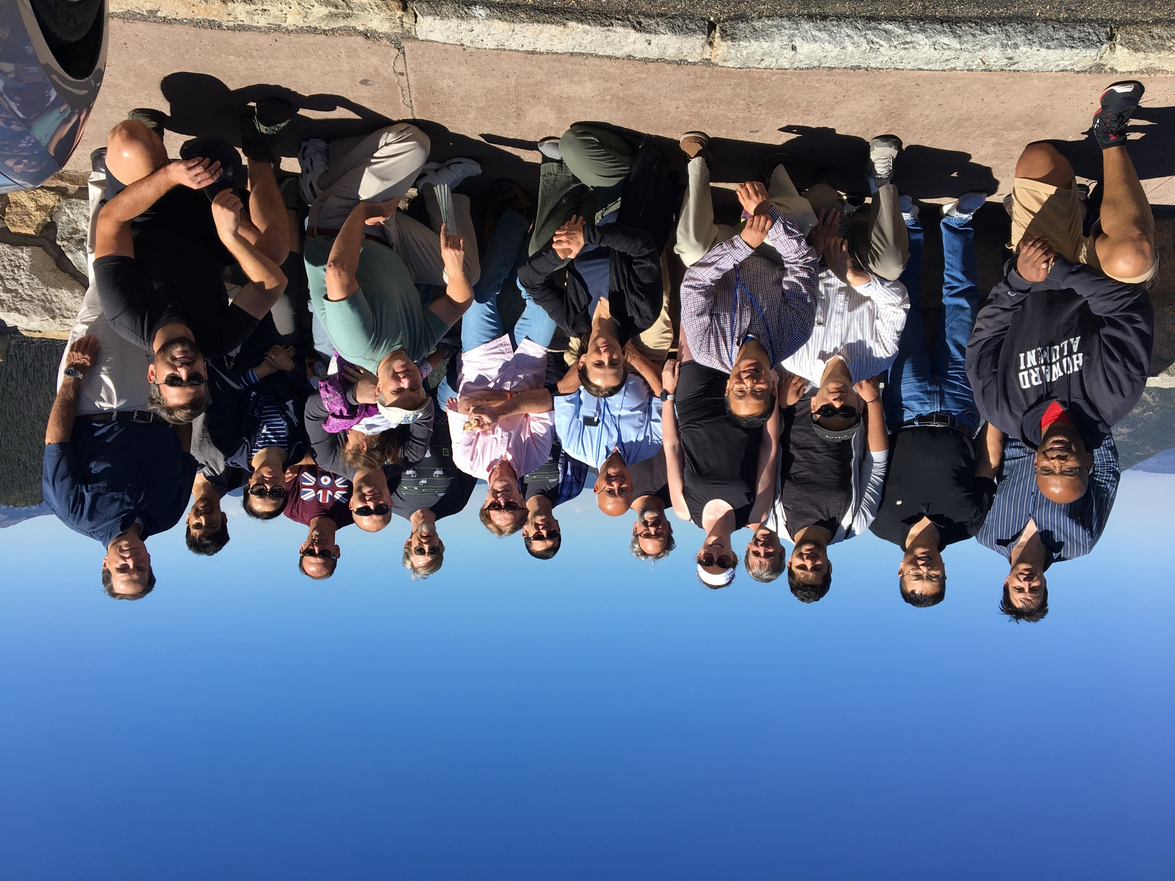
Zgoubi Workshop Summary
Suzie Sheehy
@suziesheehy
30th August 2019
Boulder, Colorado
ZGOUBI workshop participants at the Alpine Visitor Centre

Slide 2
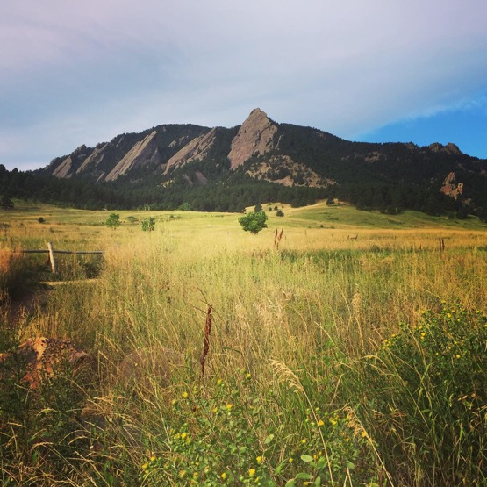

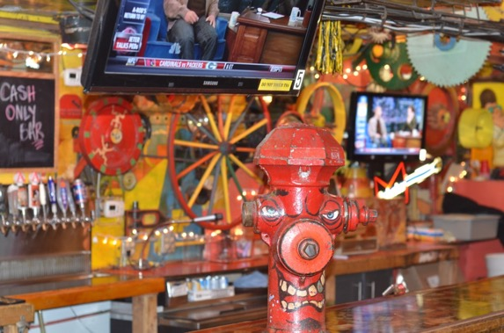
Day 0: Lessons learned
All hiking trails in Boulder are vertical
Rocky Mountain oysters are NOT a kind of seafood

Slide 3
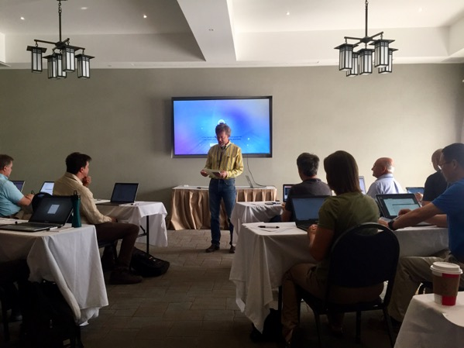
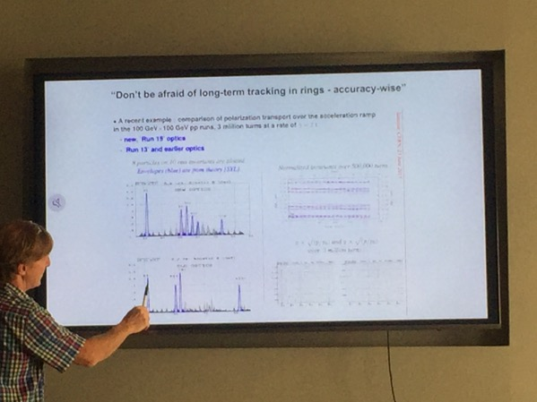
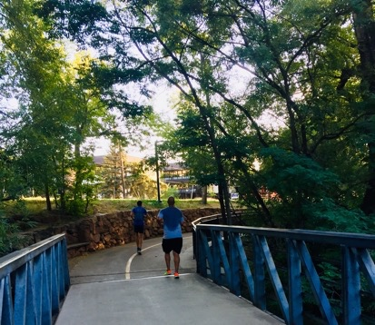
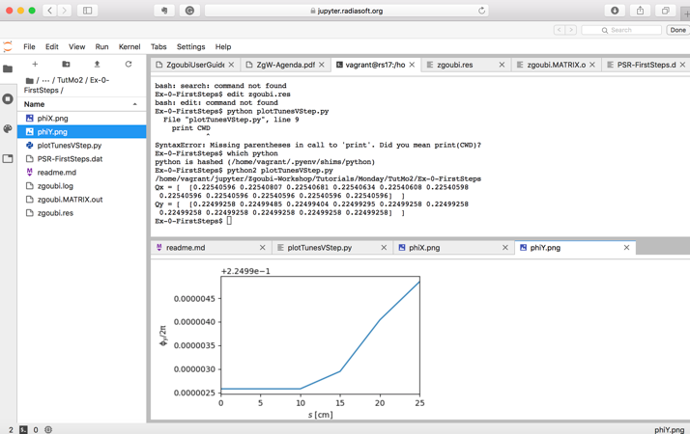
Day 1
Dan kicked us off in style…
Francois gave us a great ZGOUBI overview
Morning run: Boulder creek trail
Tutorials:
Introduction using Jupyter server
Tune as function of step size
Chromaticity calculation
Spin tracking/resonance crossing
FFA tracking
NEW: Zgoubi.TWISS.out was new (to me!)
Great that this has been included to compare/plot with MADX
Tutorial Exercise 1: tune variation with step size

Slide 4
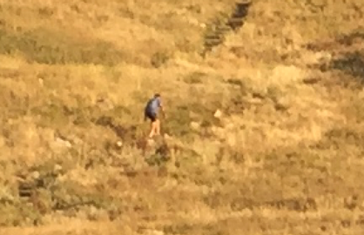
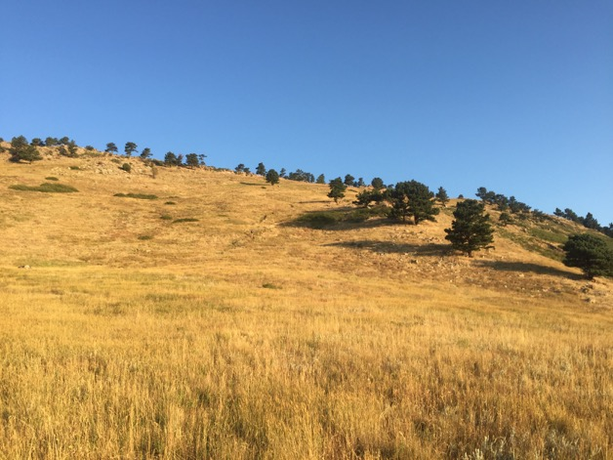
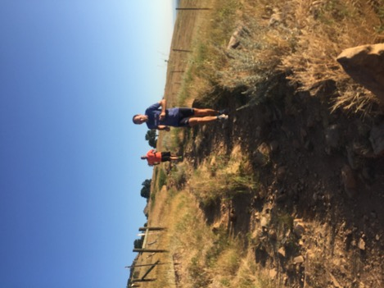
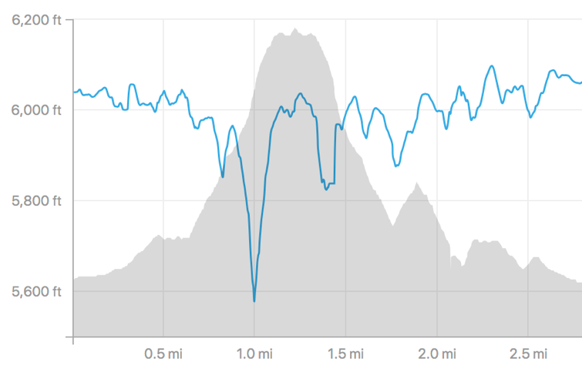
Day 2 - Tuesday
1900m (6000+ft) up… the ‘hogback ridge’ trail
Apparently a 20% gradient is considered ‘runnable’ in Boulder

Slide 5
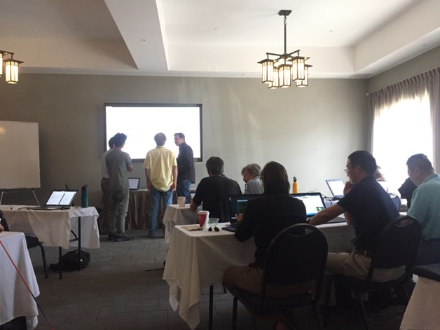
Day 2 - Tuesday
Talks:
Physics of Electron Rings — Boaz Nash
Polarized Electrons in Designs for JLEIC — Vasiliy Morozov
ESRF and JLEIC Electron Ring Simulations — Fanglei Lin & Boaz Nash
Suggestions:
Someone should make a ‘SRO’ file reader like the ‘FAI’ file reader in PyZgoubi
Synchrotron radiation through a dipole:
What are the units of EMIT3?
We dug into the source code…
Small changes: Dan updated the Makefiles on the SourceForge ZGOUBI so that Mac OSX doesn’t complain as much!

Slide 6
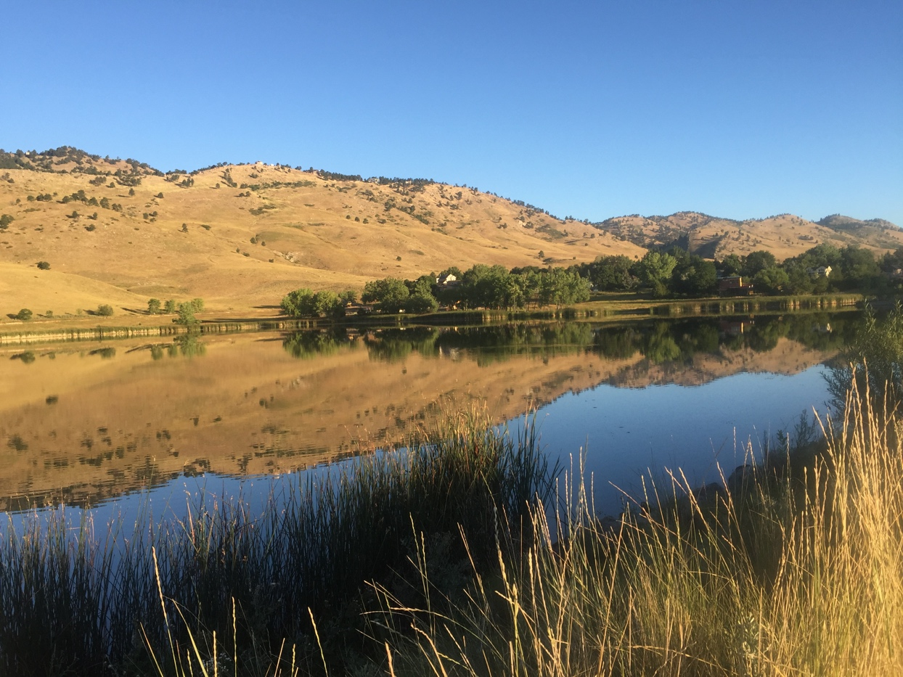
Day 3 - Wednesday
Tutorials:
CBETA ERL – Nick Tsoupas
Overlapping fieldmaps
Suggestions (from shuttle bus discussions):
Can we make a common input interface to a range of codes using the MAD-X like ‘SEQUENCE’ format?
Python-based MADX to ZGOUBI converter?
3. “Symplecticity: who cares anyway?” (working title)
Review paper – a series of benchmarked simulations in ZGOUBI vs symplectic code(?) demonstrating when it is/isn’t important.
Morning run: Wonderland Lake trail
Small changes/bugs:
’PARTICUL’ wasn’t taking charge into account when using TOSCA

Slide 7
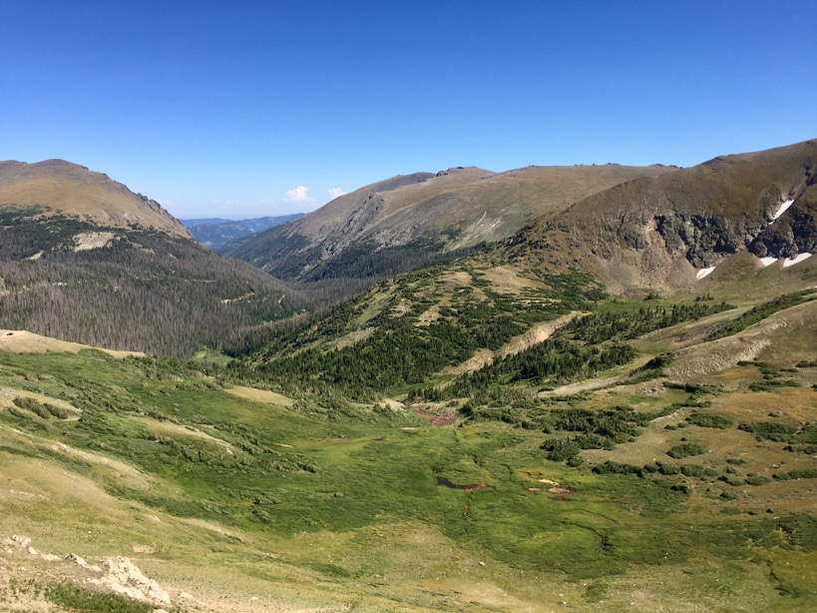
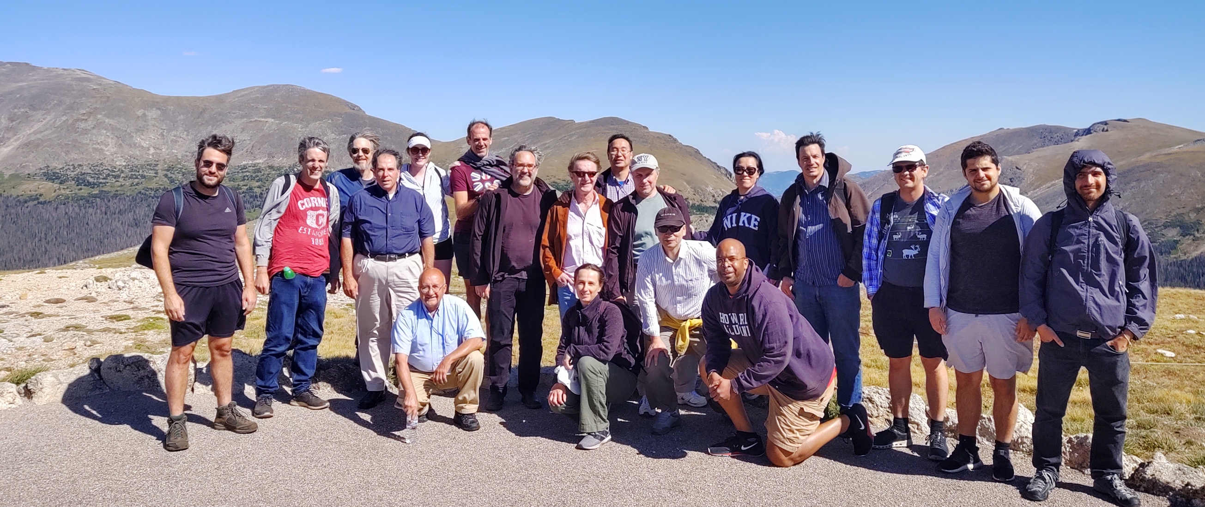
ZGOUBI workshop attendees at 12,000ft!

Slide 8
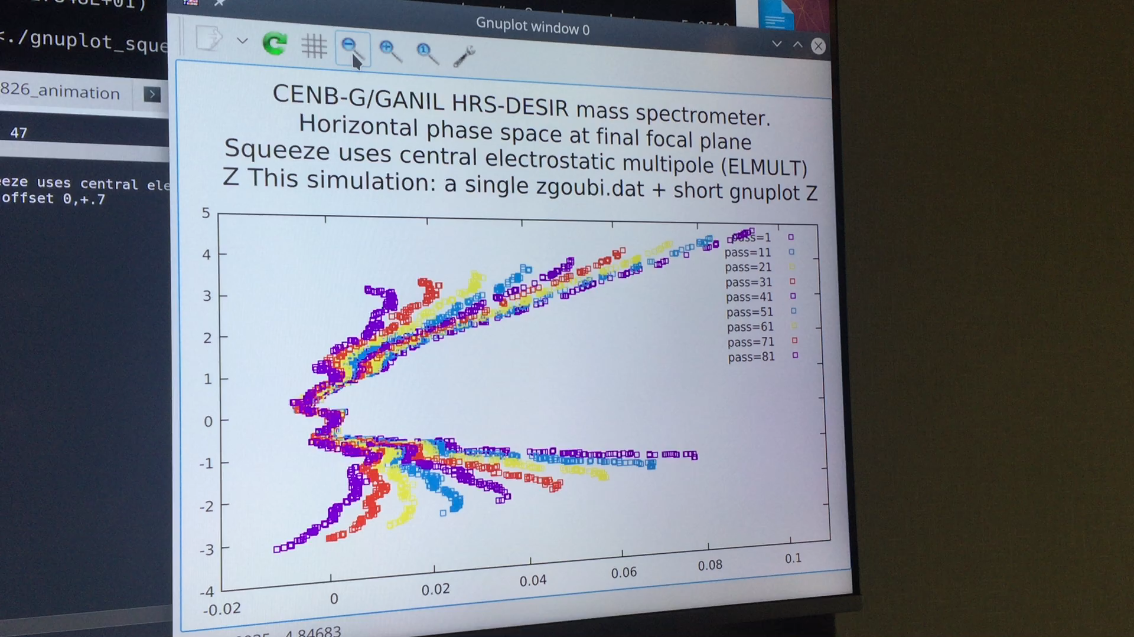
Day 4 - Thursday
Tutorials:
Laurent – Magneto and Electro-static Spectrometers and Mass Spec
Wien Filter spin rotator
We were reminded of the challenges of changing keyword i.e. BEND to DIPOLE – made easier with tools like PyZGOUBI
Nice correction of mass spec by adjusting multipole on Thurs morning
Small changes:
- The FIT2 function had been changed… can it be made consistent?

Slide 9
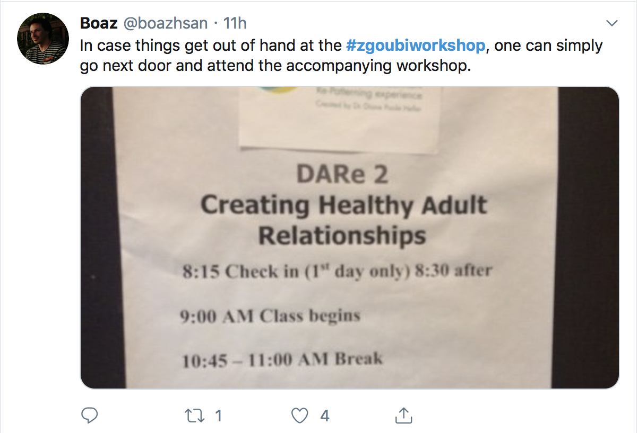
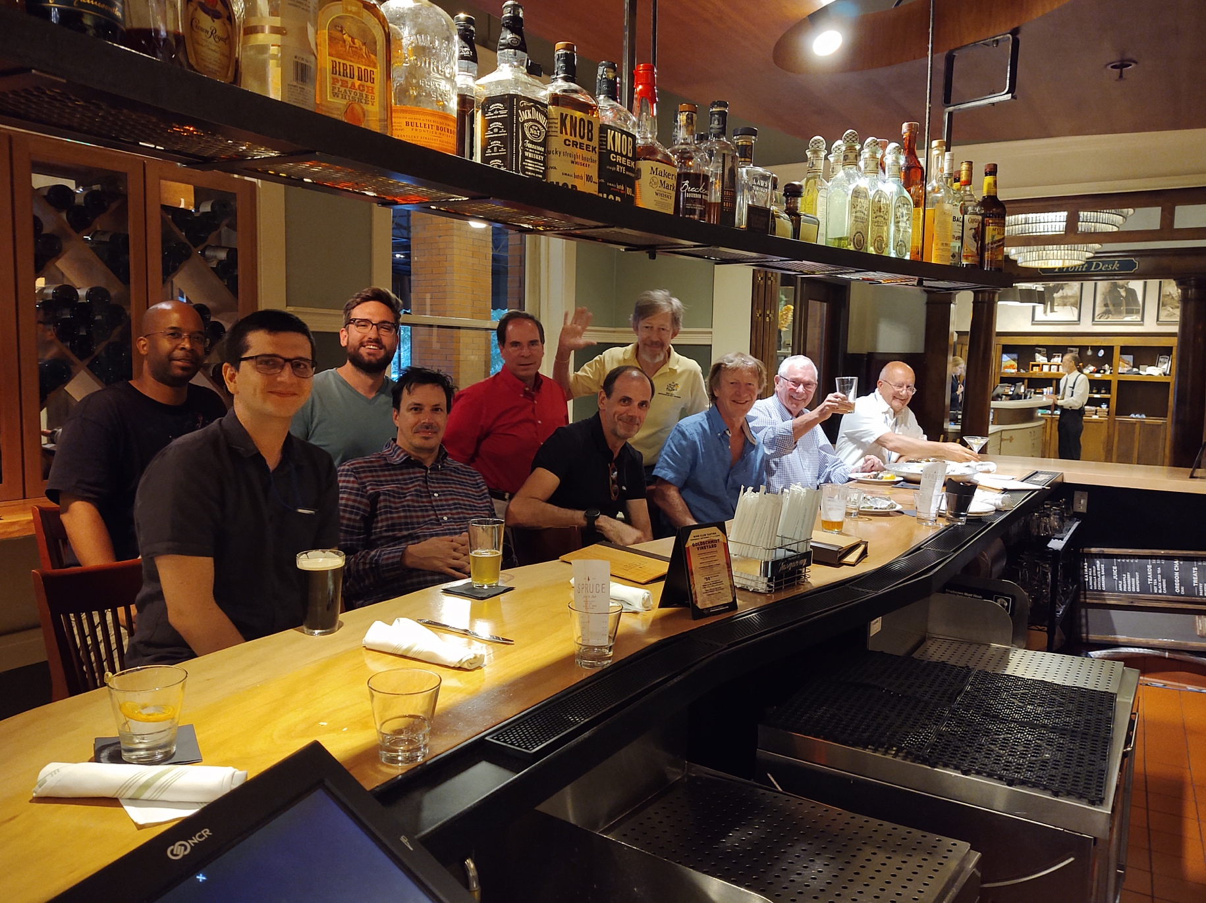

Slide 10
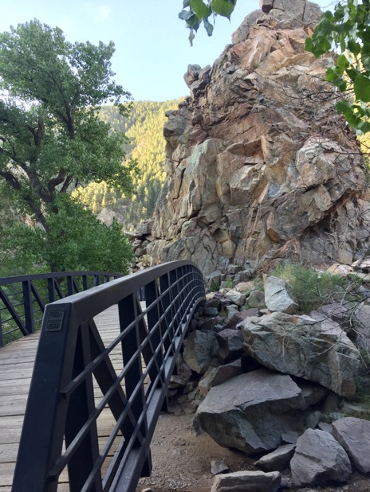
Day 5 - Friday
Dan: what we need next…
Usability:
PyZGOUBI, ZgoubiDO
Radiasoft SIREPO project for ZGOUBI
Performance:
Upgrade to Fortran2018 standards and parallelize
Symplectic tracking
Details of fringe fields in quad
Concern over off-axis accuracy
Sirepo overview of ZGOUBI by Paul
PyZGOUBI introduction by David
Morning run:
Boulder Canyon

Slide 11
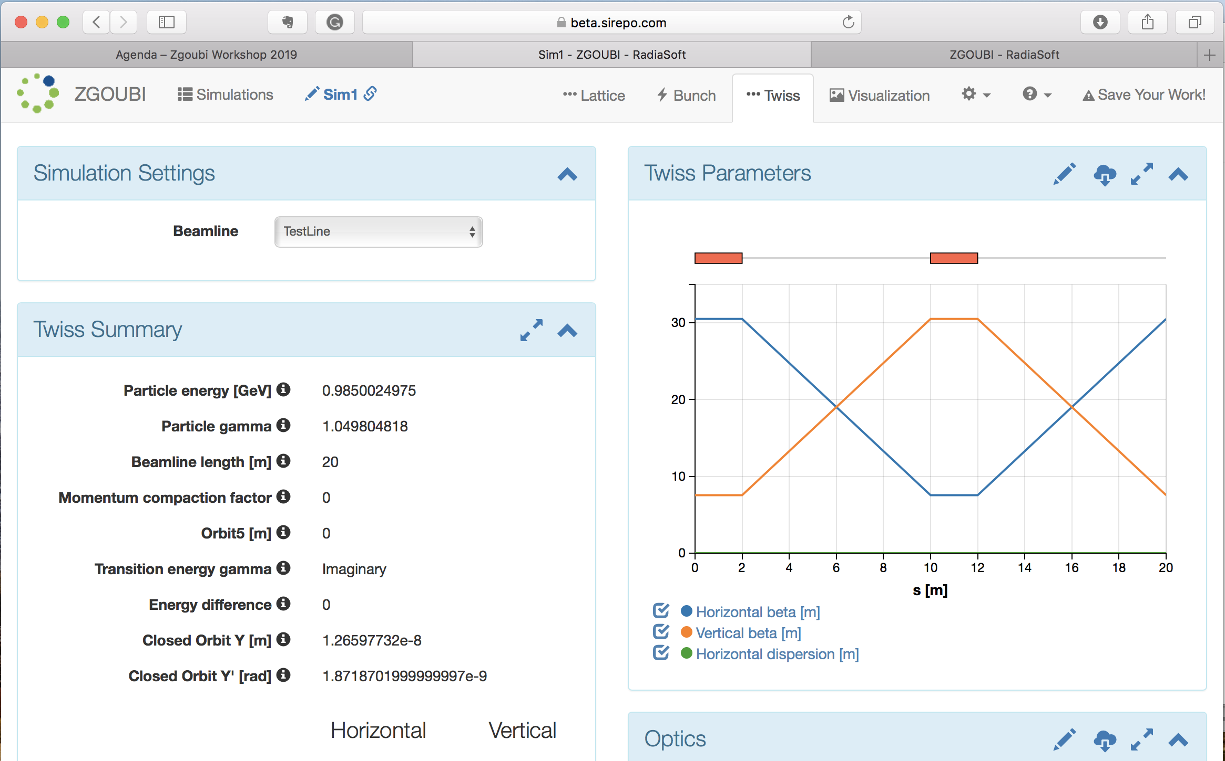

Slide 12
What new things are needed?
Examples:
Can we remove the limitation of turning a particle through 180 degrees? (i.e. medical LINACs have a 270 degree bend)
How can we implement a consistent set of units (SI?) in ZGOUBI?
Can we create a mailing list or forum for ZGOUBI users or developers? (Central place to communicate?) archived & searchable would be useful.

Slide 13
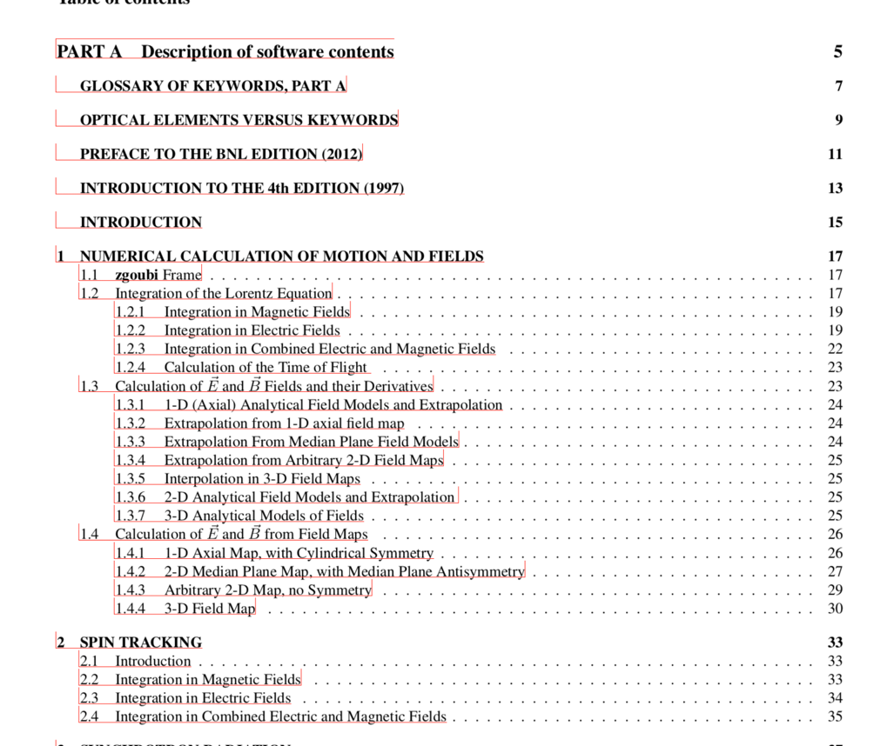
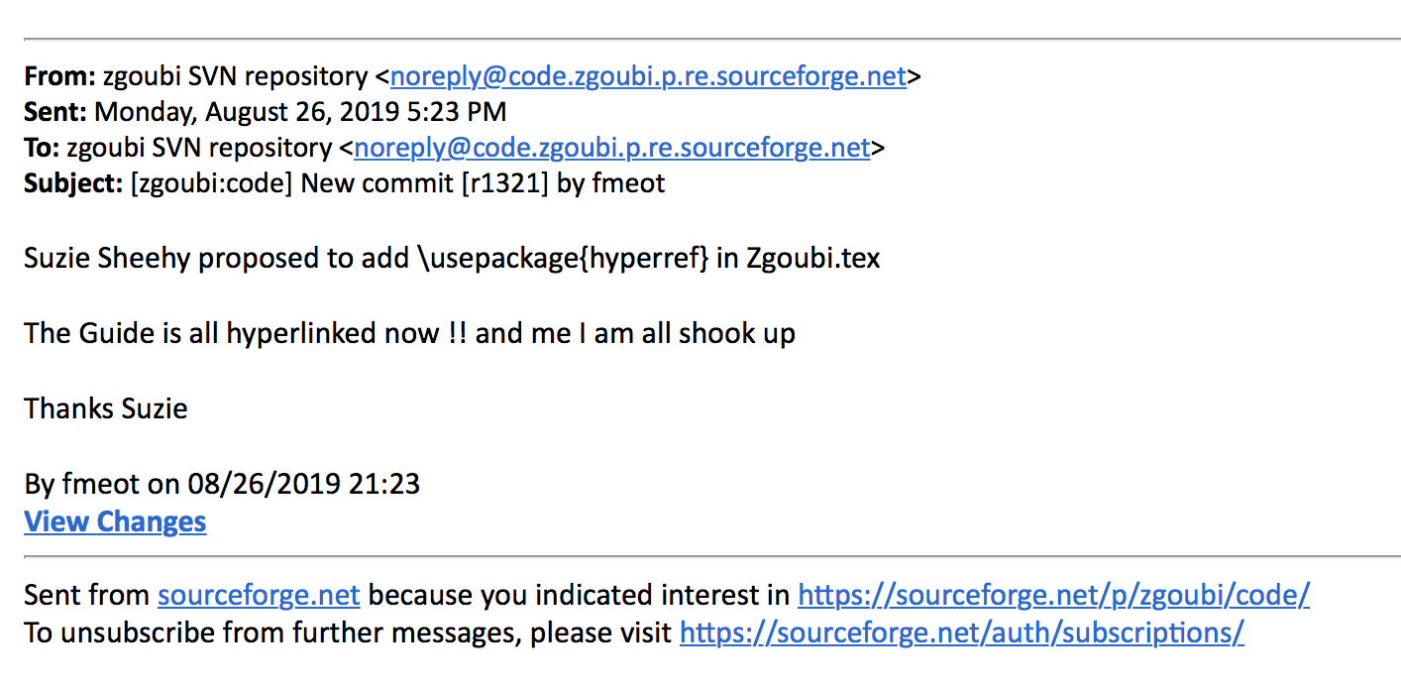
What Francois learned this week:
\usepackage{hyperref}
ZGOUBI manual is now CLICKABLE!

Slide 14
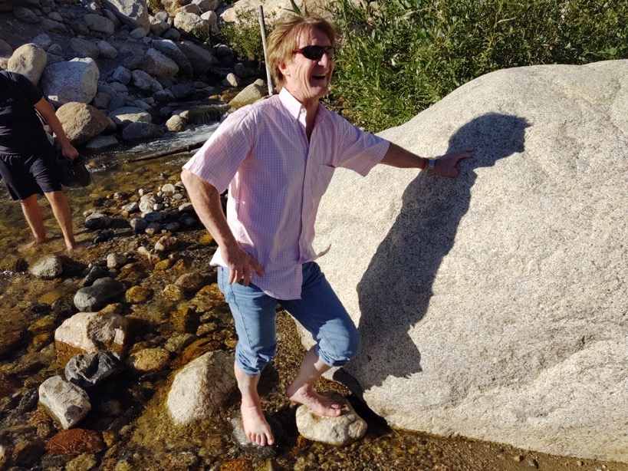
What we learned about Francois this week:

Slide 15
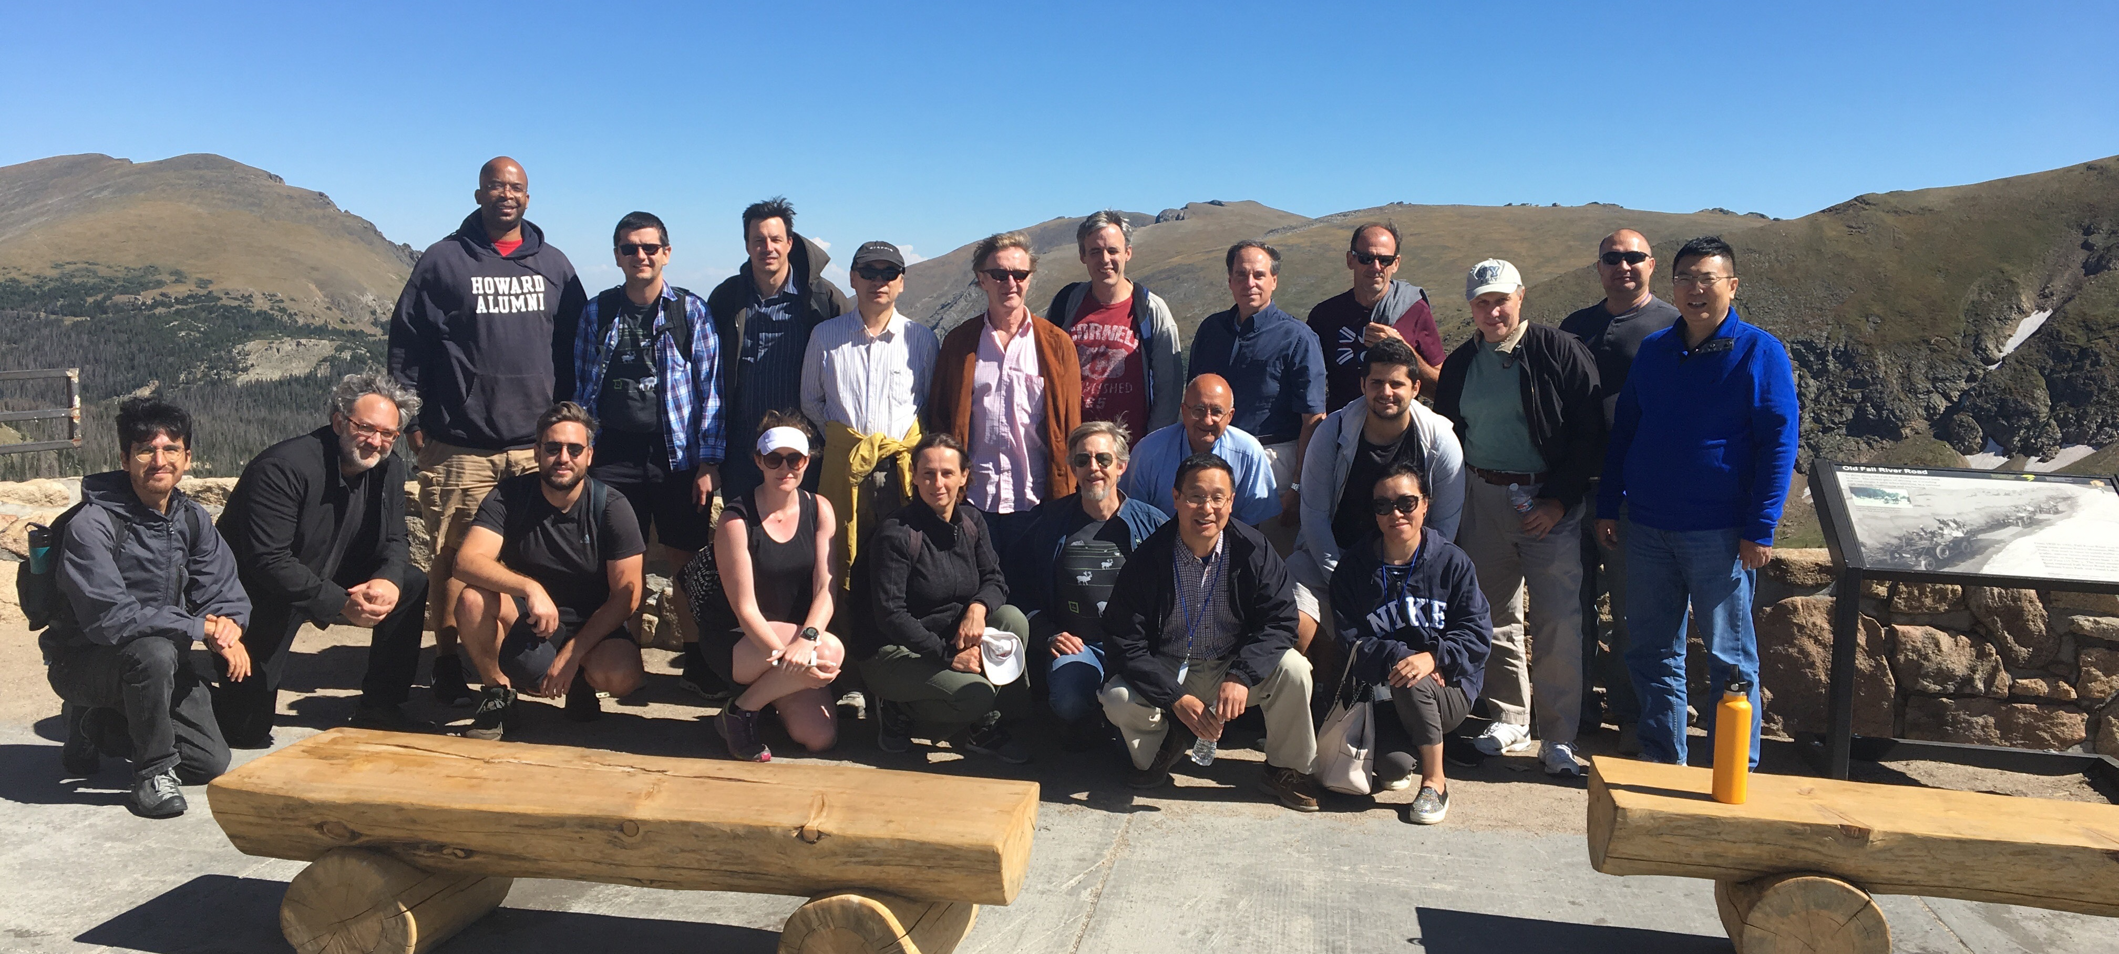
Talks available at: https://github.com/radiasoft/Zgoubi-Workshop/

